Slide 1
Maximum Cardinality Matching
Progress Report, 7.11.2016
Isa Roesch, Samuel Ueltschi, Conradin Roffler, Thomas Meier

Slide 2
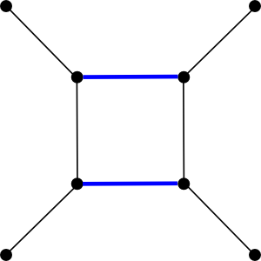
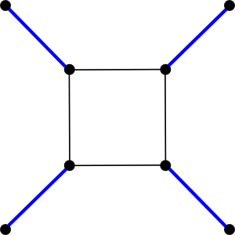
Maximum Cardinality Matching
Maximum Matching
Maximum-Cardinality Matching
Pictures taken from boost.org

Slide 3

State of the Art
Pothen Fan $O(nm)$ [1]
Hopcroft Karp $O(\sqrt{n}m)$ [2]
Tree Grafting $O(nm)$ [3]
[1] https://pdfs.semanticscholar.org/6eda/a726a61c0c059cc1ab553abd02539fd81573.pdf
[2] J. Hopcroft and R. Karp, “A n5/2 algorithm for maximum matchings in bipartite graphs,” SIAM J. Comput., vol. 2, pp. 225–231, 1973.
[3] https://www.cs.purdue.edu/homes/apothen/Papers/cardinality-matching-TPDS-2016.pdf

Slide 4
Pothen-Fan
A
A
1
B
2
2
C
C
3
D
4
4

Slide 5
Pothen-Fan
A
A
1
B
2
2
C
C
3
D
4
4

Slide 6
Current State
G = (U, V) |V| = 73364, |E| = 88328, n = 50, CI = 95%, Speedup = 11

Slide 7
Future Steps
Tune parallel Pothen-Fan for Xeon Phi
Benchmark with SuiteSparse Matrix Collection
Roadmap USA
Wikipedia
Amazon.com
SparseMatrix: http://www.cise.ufl.edu/research/sparse/matrices/

Slide 8
Thank you for your attention

